Slide 1
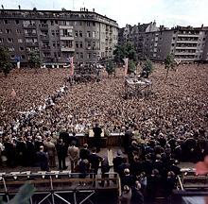
June 26, 1963
Ich bin ein Berliner…
CIPS INSTRUCTOR

Slide 2
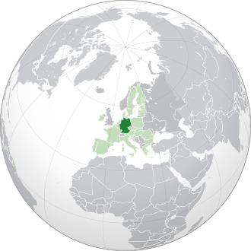
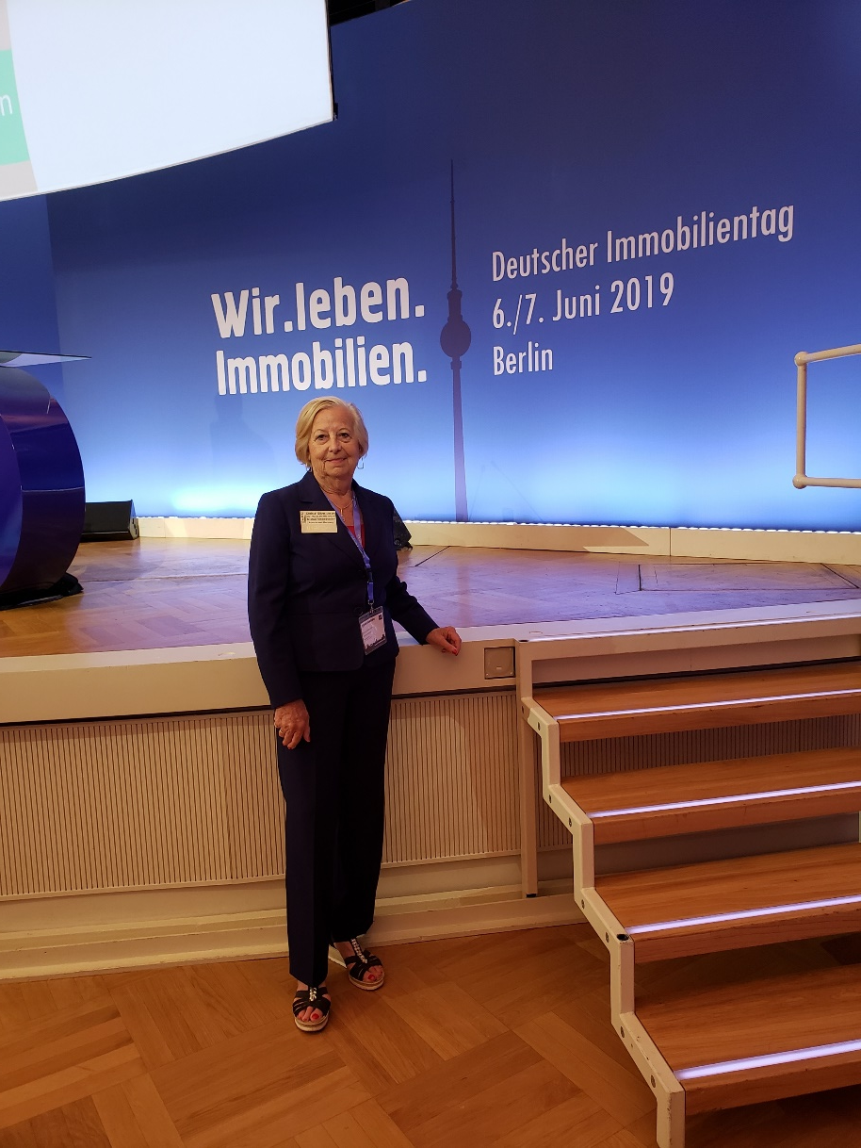
GeRmany
Germany:
Area: 137,847 sq mi
Population: 83,166,711
Florida
Area: 65,757.70 sq mi
Population: 21,477,737
Values
Germans place a high priority on structure, privacy and punctuality. The German people embrace the values of thriftiness, hard work and industriousness and there is great emphasis on making sure that "the trains run on time."
Germans are stoic people who strive for perfectionism and precision in all aspects of their lives. They do not admit faults, even jokingly, and rarely hand out compliments.
CIPS Instructor
a

Slide 3
In this difficult time you should get educated, make plans to become a Global Realtor® - but do not forget to stay healthy! Let’s START!
CIPS Instructor

Slide 4
You can sell to the whole world:
but you cannot be a specialist for every country!
CIPS Instructor

Slide 5
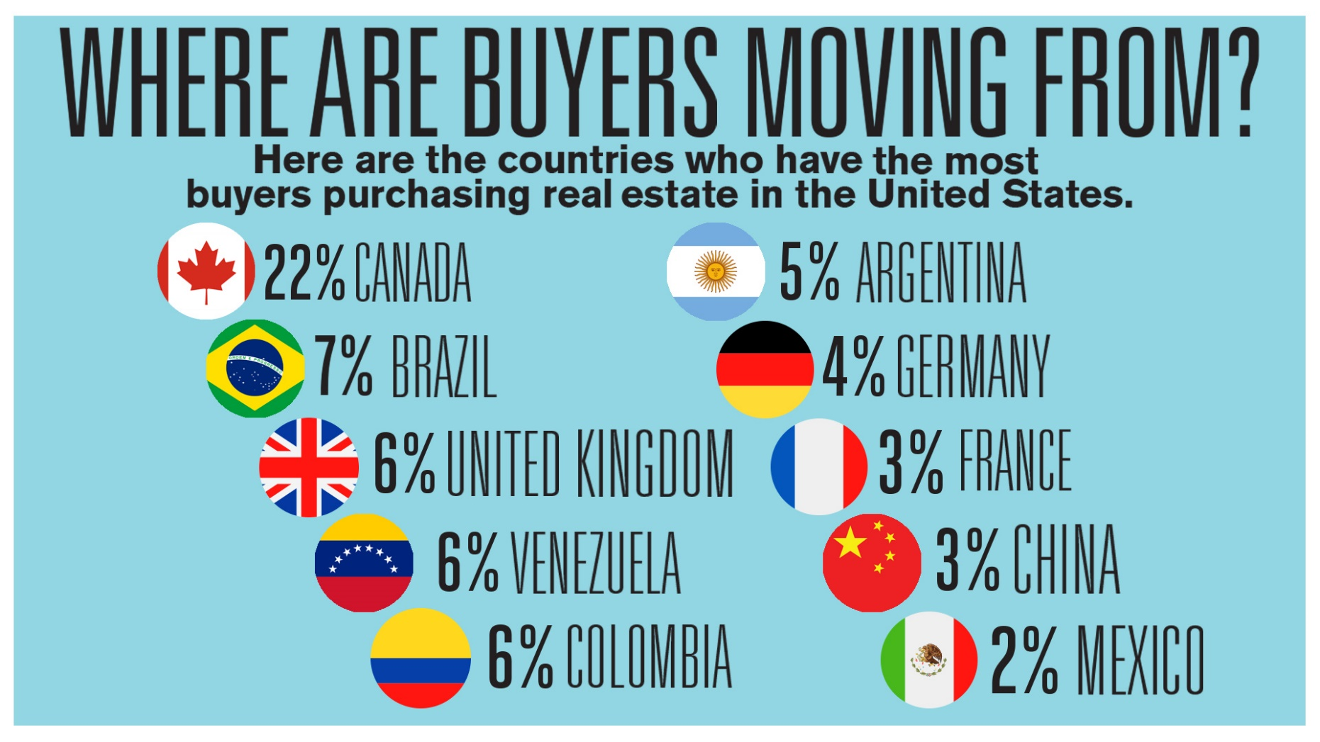
CIPS Instructor

Slide 6
CIPS Instructor

Slide 7
Where do you find international clients?
CIPS Instructor

Slide 8
CIPS Instructor

Slide 9
Do you have a favorite country for vacations?
CIPS Instructor

Slide 10
Time to join an International Club in your neighborhood!
CIPS Instructor

Slide 11
You do not need to speak a foreign language, no but…. Surround yourself with CPA, Attorney, Inspector, Banker, who speak the language of your foreign client!
CIPS Instructor

Slide 12
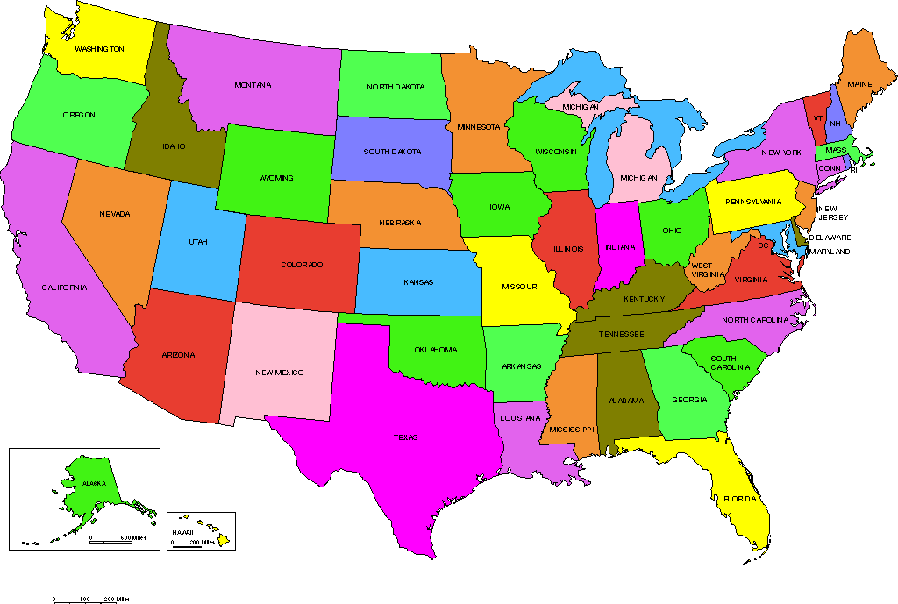
International clients want international expertise If you are going to compete in the global luxury market, you must also be familiar with not only what is happening domestically, but what is happening internationally.
CIPS Instructor

Slide 13
Most International Buyers are paying
CASH!
CIPS Instructor

Slide 14
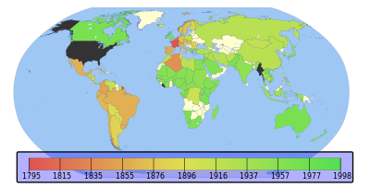
Metric System adopted in the world except a very few countries:
USA , Liberia and Burma
CIPS Instructor

Slide 15
Withholdings! Estate Tax 40%!
(FOREIGN INVESTMENT IN REAL PROPERTY TAX ACT OF 1980)
CIPS Instructor

Slide 16
…or join an International Organization:
CIPS Instructor

Slide 17
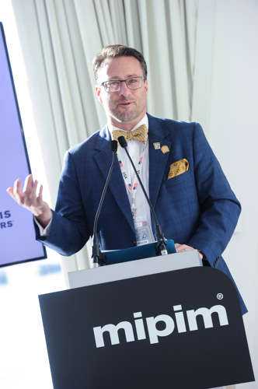
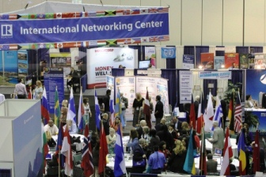
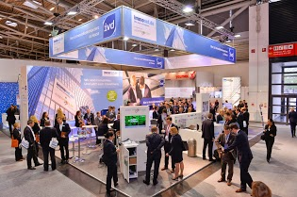
Travel to Real Estate Meetings:
CIPS Instructor

Slide 18
EXPO REAL 2020 in a new format
Physical and virtual meeting place for the real estate industry: the EXPO REAL Hybrid Summit will take place in the ICM – Internationales Congress Center München on October 14 and 15, 2020.
CIPS INSTRUCTOR

Slide 19
Ambassador Association: Costa Rica
Ambassador Association: Costa Rica

Slide 20
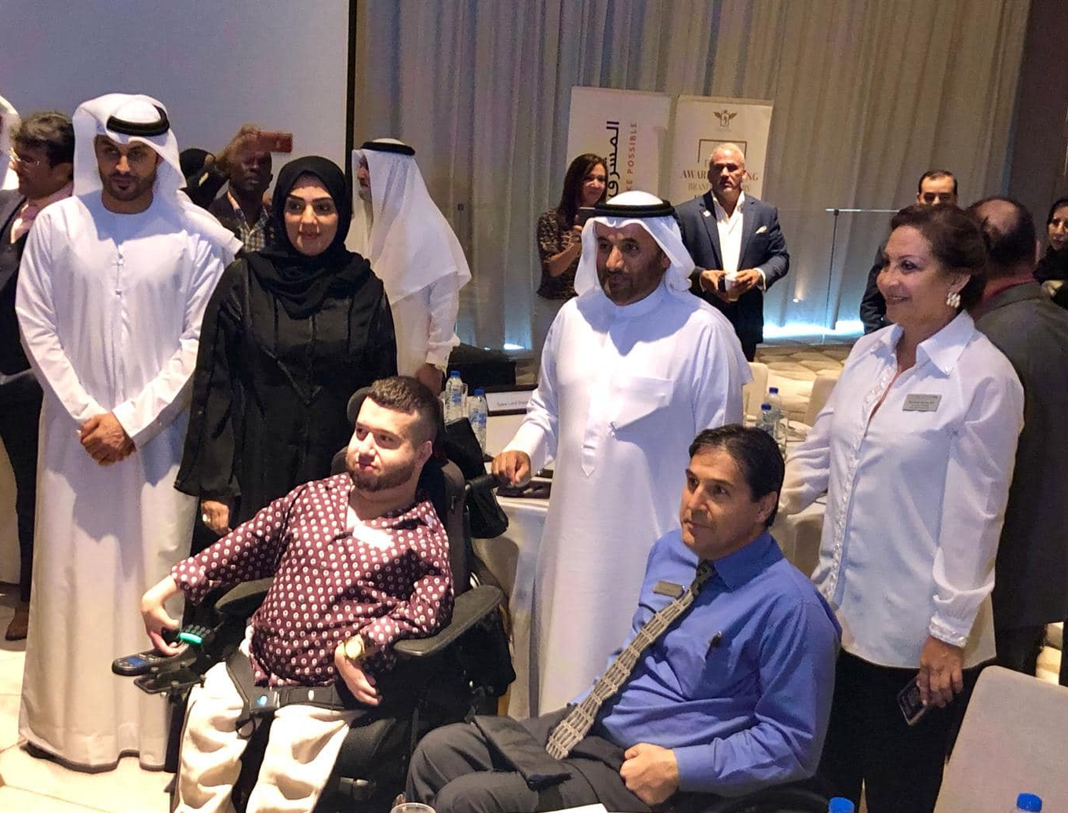
Learn about the cultural differences!
CIPS Instructor

Slide 21
https://www.nar.realtor/global-perspectives/building-bridges
ONE
OK
INSULT
CIPS Instructor

Slide 22
Instantly align yourself with the best in international real estate by earning the CIPS designation. CIPS designees are connected to an influential network of over 3,500 professionals who turn to each other first when looking for referral partners.
CIPS Instructor

Slide 23
BENEFITS?
Monthly Newsletter
with Updates
Closed Facebook Group
CIPS Instructor

Slide 24
Typical CIPS Facebook post:
Question:
Does anyone work in Greece in this CIPS group?
Answer: Check with Angela Eliopolous. She is a DC agent with a brokerage in Greece.
CIPS for about 20 years. She’s actually in Greece now.
CIPS INSTRUCTOR

Slide 25
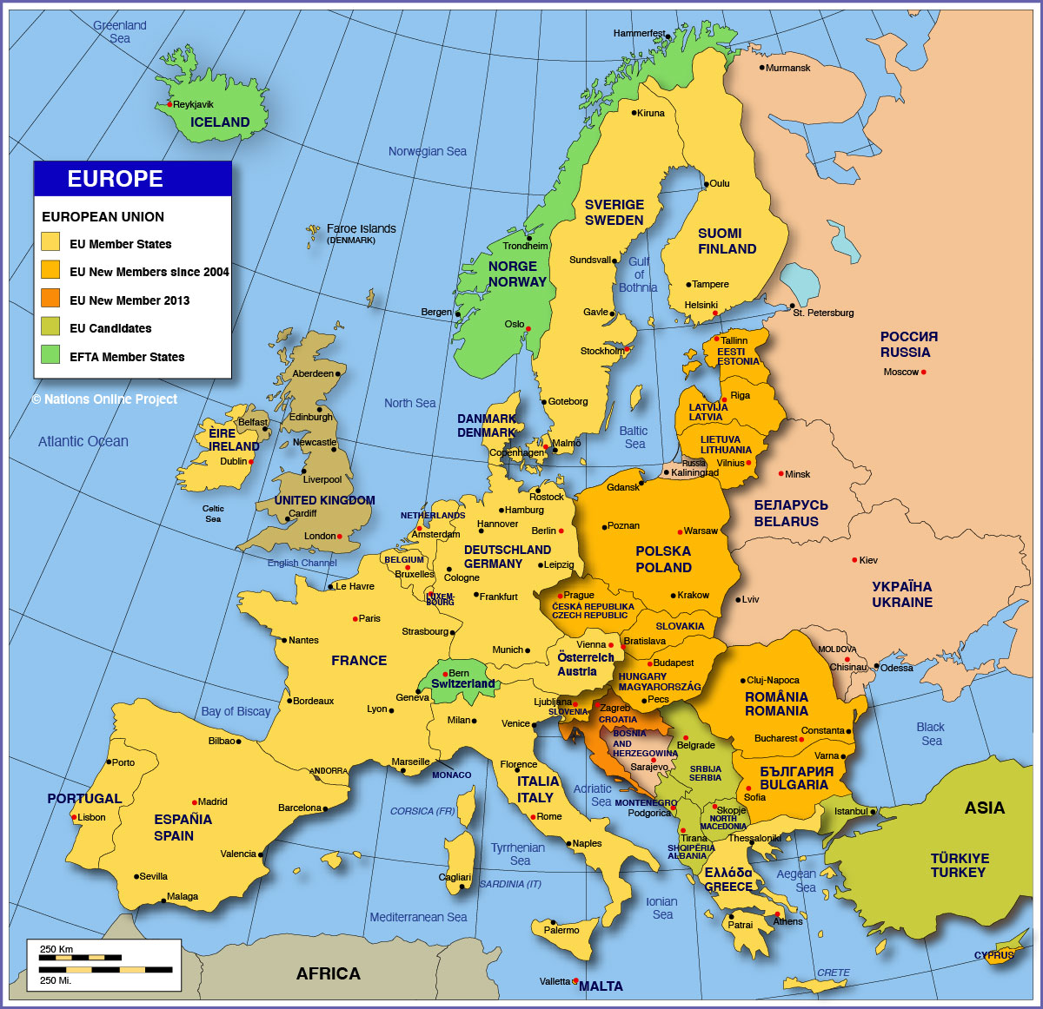
European EUROPEan Union Union
CIPS Instructor

Slide 26
1) Andorra 2) Austria 3) Belgium 4) Cyprus 5) Estonia 6) Finland 7) France 8) Germany 9) Greece 10) Ireland 11) Italy 12) Kosovo
13) Luxembourg
14) Malta 15) Monaco 16) Montenegro 17) Netherlands 18) Portugal 19) San Marino 20) Slovakia 21) Slovenia 22) Spain 23) Vatican City
Today, the euro is one of the world's most powerful currencies, used by more than 320 million Europeans in twenty-three countries. The countries currently using the euro are:
CIPS Instructor

Slide 27
IMPORTANT: Germany has 8656 notaries in 1785 cities
Appointments are made by the department of justice.
In Germany and many other European
Countries: Do NOT compare a NOTAR
with “our” NOTARY!
CIPS INSTRUCTOR

Slide 28
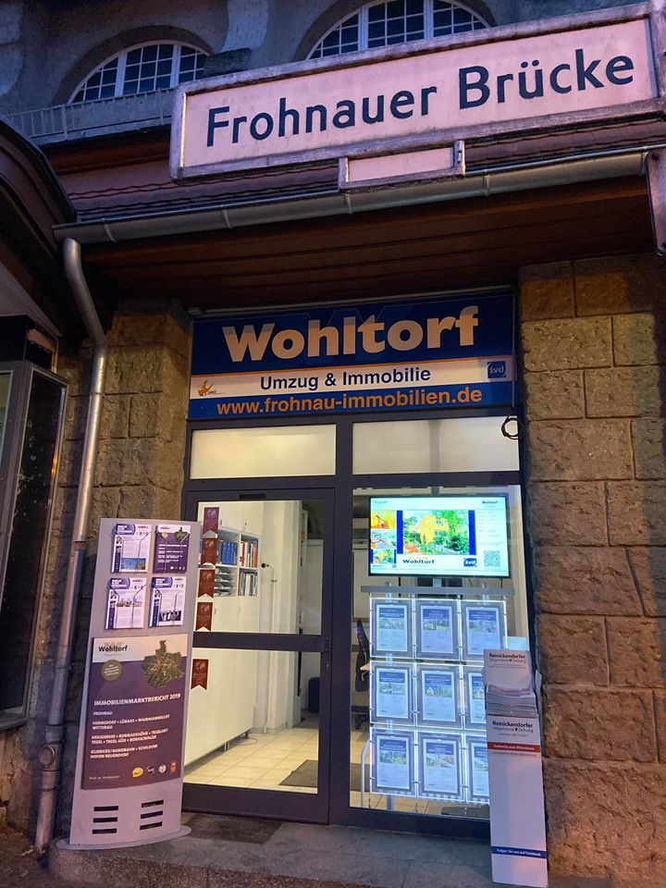
How to become a Real Estate Agent in Germany?
CIPS INSTRUCTOR

Slide 29
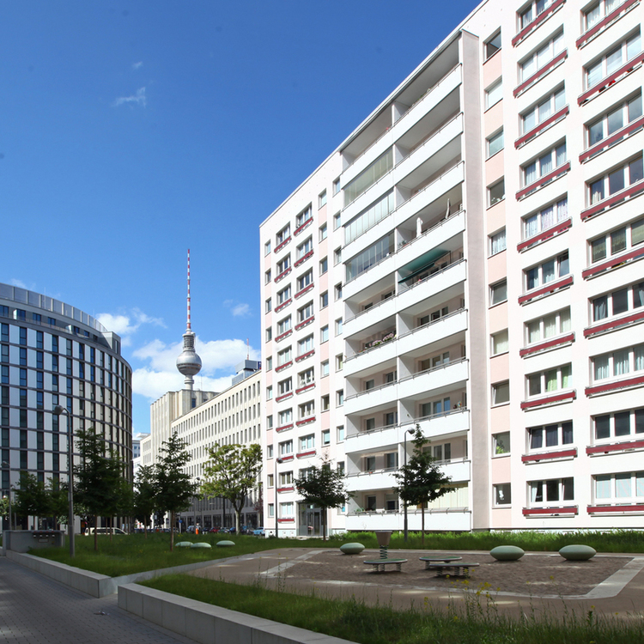
338,000 EUR
Asking price
54.3 m²
Living space
3.0
$379,912
Listprice
584.50 sf (10.764)
Living Space
3.0 rooms
CIPS INSTRUCTOR

Slide 30
Rent vs Own
CIPS INSTRUCTOR

Slide 31
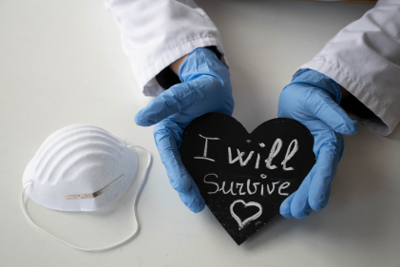
Update dur
According to the Cologne Institute for
Economic Research (IW), the housing
market should come through the coronavirus
crisis relatively unscathed.
According to a new IW study, residential
property prices will probably not fall at all or,
if they do, the declines will be moderate.
CIPS INSTRUCTOR

Slide 32
Update during Covid-19
CIPS INSTRUCTOR

Slide 33
Effective Date December 23, 2020
CIPS INSTRUCTOR

Slide 34
CIPS Instructor

Slide 35
“Hold” the world in your hands! Feel free to contact me with any questions: Christel Silver 561-929-5799 or chs@silverhouses.com
CIPS Instructor

