Slide 1

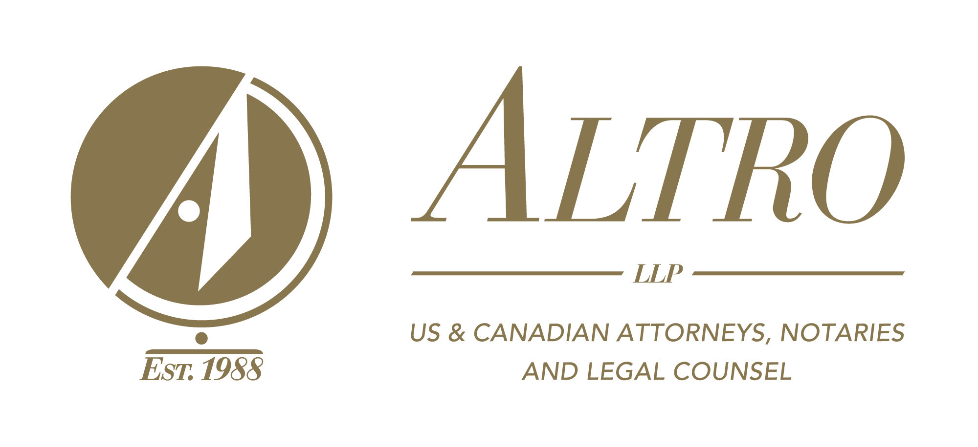
Montréal / Toronto / Calgary / Vancouver / Ft. Lauderdale / Orlando / Naples / Phoenix / Palm Springs
AUGUST 16 2018
OWNING U.S. PROPERTY THE CANADIAN WAY
REAL ESTATE For Canadian Snowbirds IN SWFL
David A. Altro, B.A., LL.L., J.D., D.D.N., F.Pl., TEP
Managing Partner, Florida Attorney &
Canadian Legal Advisor
daltro@altrolaw.com
1.888.GO.ALTRO / www.altrolaw.com

Slide 2

David A. Altro
B.A., LLL., J.D., D.D.N., F.Pl., TEP
Managing Partner of ALTRO LLP
Florida Attorney, Canadian Legal Advisor & Foreign Legal Consultant
Practicing law for over 35 years
Author of several books, including:
  Owning U.S. Property the Canadian Way, Third Edition
  Americans Living in Canada – Smile, The IRS is Watching You
Special contributor to the Globe and Mail
Interviewed on CTV, CBC, radio and many newspapers
Frequent presenter at legal and tax conferences in Canada & US
Post-Graduate Legal Studies (D.D.N.)
Juris Doctor (J.D.)
Civil law degree (LL.L.)
Bachelors of Arts degree (B.A. Honours)
Admitted to the Quebec Bar in 1980
Admitted to the Florida Bar in 1984
Member of the Society of Trust and Estate Practitioners
Former member of TIGER 21
Board of Directors of the Maimonides Geriatric Center
Former partner at Holland and Knight, Miami, FL

Slide 3
In Your Experience
Has anybody worked with a Canadian buyer but had a legal or tax question come up?
Have you ever had a Canadian buyer purchase a home in an LLC?
What are the 5 FAQs you get from Canadian buyers?

Slide 4
What is your buyer thinking?
Loves Florida
Hates the cold winters in Canada
Worries about US capital gains taxes, estate tax, how to take title, and probate costs
What about financing?
Where can good advice be found?
  Worried a Florida lawyer won’t know the cross border tax issues
  Worried that a Canadian lawyer won’t know the IRS and Florida cross border issues
  Do accountants know?
  “A Florida lawyer told me it is best to put title in an LLC.”

Slide 5
What are you, the Realtor, thinking?
Client seems really interested
One spouse is concerned about buying real estate in a foreign country
  What is he/she concerned about?
  How do I answer their questions about tax, LLCs, Trusts, etc.?
  How can I alleviate their concerns?
  Cross-Border Professionals
    We recommend a consultation with ALTRO LLP, Canadian and Florida expert cross border attorneys, with offices in Florida and Canada.

Slide 6
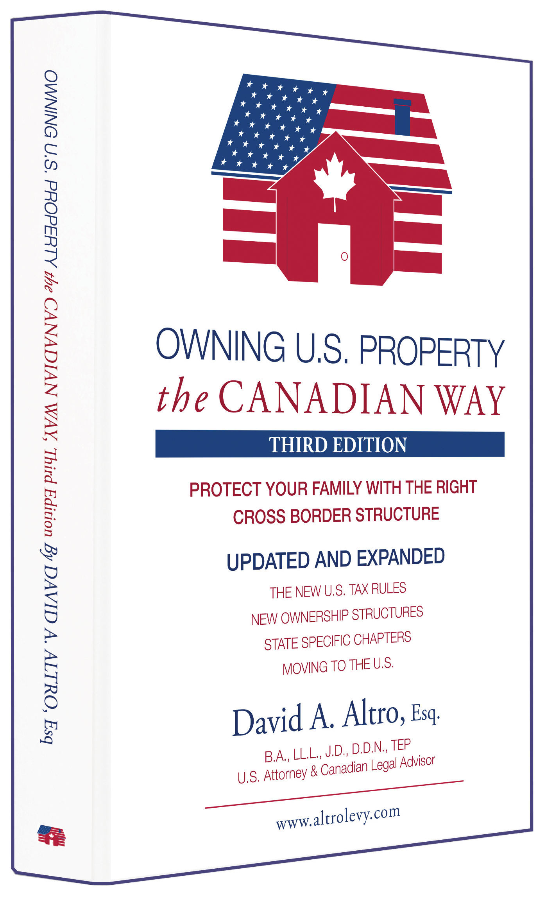
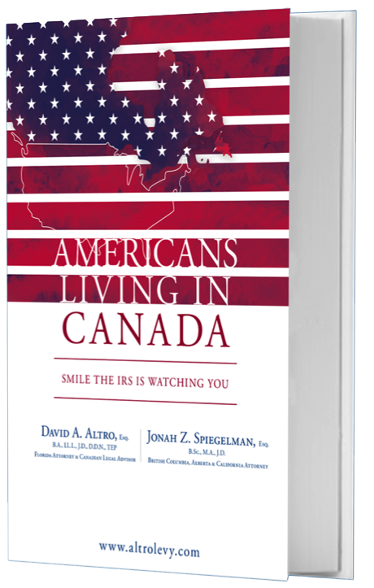
What do you want to learn from this seminar?

Slide 7
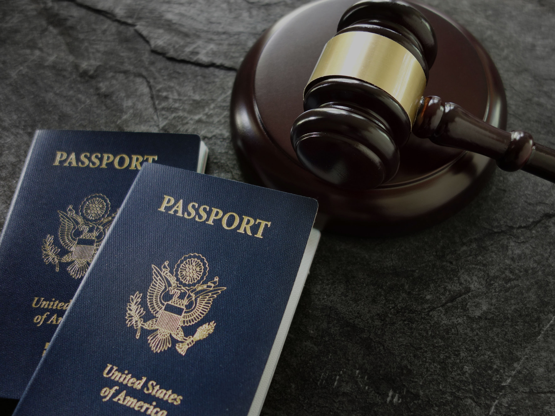
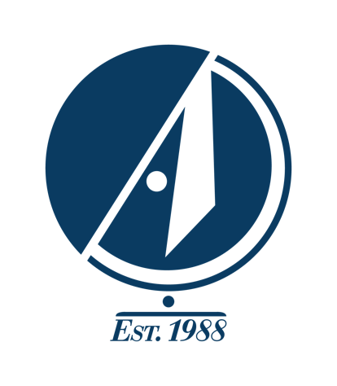
5 Tax Traps for Canadians who Own US Property

Slide 8
Do’s and Don’ts
The tax world has changed a lot in recent years
Be aware of the following Tax Traps:
  US LLCs and Florida revocable trusts
X
  US LLLPs and LLPs
X
  Gifting US real property
X
  Joint tenancy with right
  of survivorship
X
  Canadian corporations
X

Slide 9
1. US LLCs and Florida Revocable Trusts
US Limited Liability
Companies (LLCs)
Taxed as partnerships in the US
Taxed as corporations in Canada
  This causes potential:
    Double taxation;
    A “taxable benefit” for Canadian income tax purposes; and
    Higher overall income taxes.
Revocable Trusts &
Florida Land Trusts
  Trust is taxed for Canadian tax purposes
  Potential double taxation

Slide 10
2. US LLPs and LLLPs
Limited Liability Partnerships
US Limited Liability Limited Partnerships
Potential double taxation
Problem of classification by Canada Revenue Agency
  Canadian tax treatment uncertain

Slide 11
3. Gifting US Real Property
Not eligible for utilization of lifetime gift tax exemption
Subject to gift tax at 40% of the value of the gift over:
$152K to spouse; or
$15K to others
The Canadian attribution rules
  Canadian deemed disposition capital gains rules

Slide 12


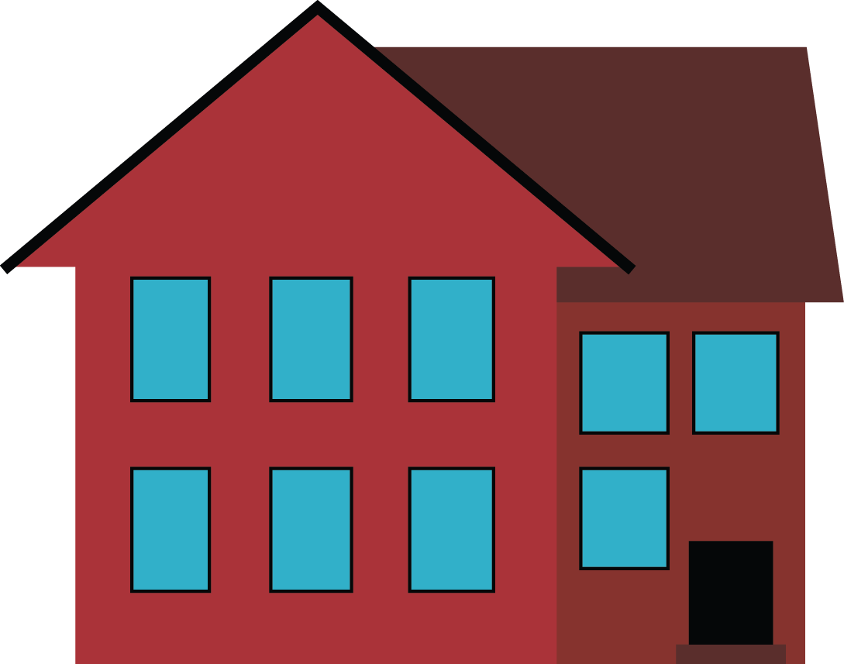
4. Canadian Corporations
US real estate owned by your Canadian corporation
Can cause shareholder benefit issues
  Can result in significant tax costs
If purchased after 2004 for personal use
Canadian tax issue
Use is considered a taxable shareholder benefit by the CRA
  Generally considered the value of hypothetical rental income
100%
CDN CORP.
100%
U.S. CORP.

Slide 13

5. Joint Tenancy with Right of Survivorship
Potential double taxation on death
Potential US estate tax on death of first spouse
Estate tax again on second spouse to die
x2

Slide 14

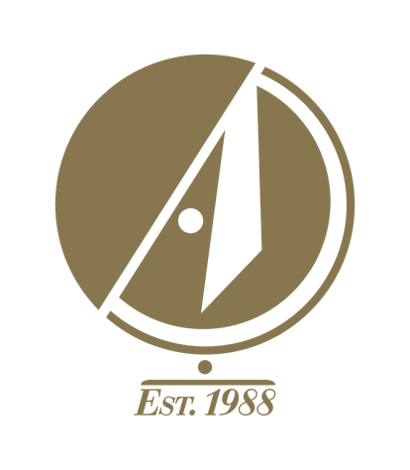
Cross Border Planning Considerations

Slide 15
Probate
Probate is the legal procedure before the county probate court where the property is located
  It is a public procedure
Your estate will be subject to Florida probate if you pass away owning property in your name alone
Expensive (approximately 3% of property value)
Time consuming (up to a year)
Freezes the estate

Slide 16
US Estate Tax
Trump’s US Tax Reform doubled the US estate tax exemption amount
Does it apply to Canadians owning U.S. assets?
  Are your U.S. assets > $60,000 U.S.?
  Is the value of your worldwide estate > $11,200,000?
U.S. Situs assets
  What is in?
  What is out?
Worldwide estate
  Everything counts!
Double-up the exemption under the Tax Treaty
TRUMP
EFFECT
US Estate Tax:
Exemption amount doubled to $11.2 M per person/spouse

Slide 17

Planning with Trusts
There are many kinds of Trusts for many different purposes
The question is: which is the right kind of Trust for you?
The wrong kind can lead to double taxation

Slide 18
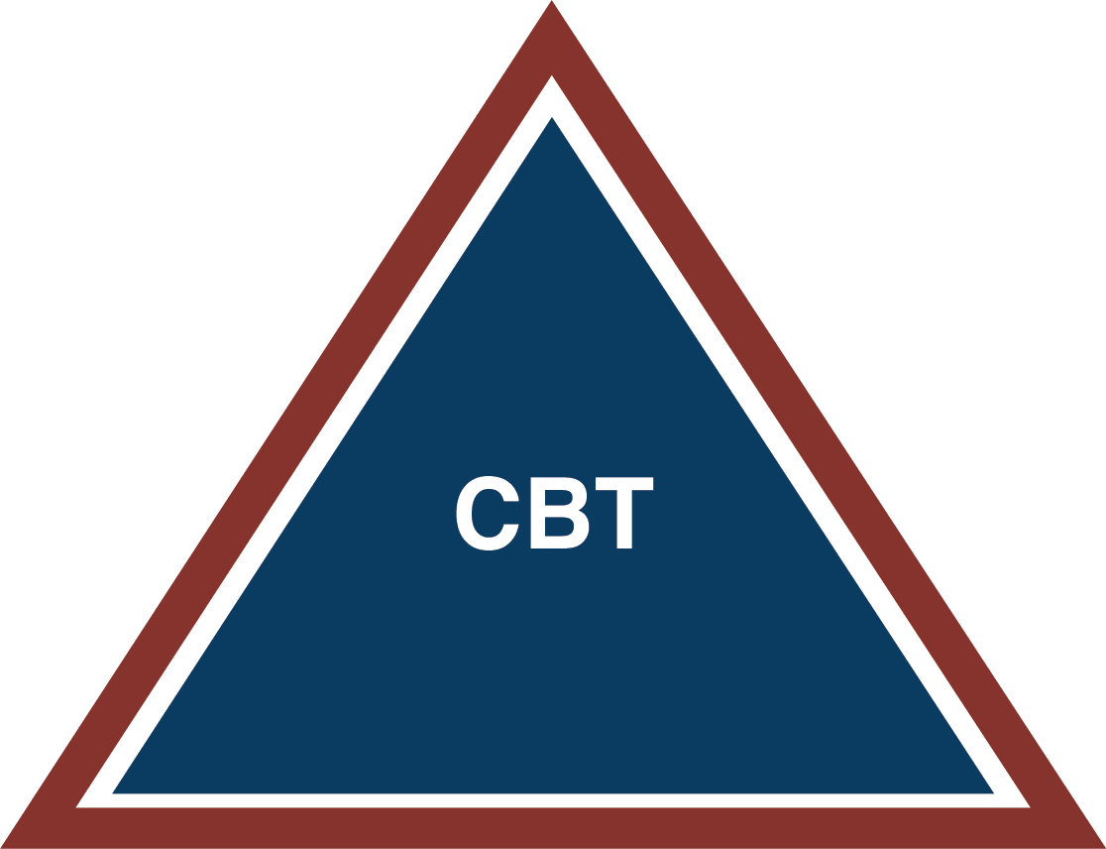
Cross Border Trust
Florida probate issues
Florida mental incapacity issues / guardianships
US capital gains and income tax
Canada Revenue Agency capital
gains and income tax
Foreign tax credits under the
Canada-US Tax Treaty
US Estate Tax
Protecting your children’s inheritance from
divorce marital assets
Asset protection for your children’s inheritance
Trustee:
You
Beneficiaries:
You

Slide 19
Other Personal-Use Ownership
Structures: The Issues
Structure | Issue
LLC | Double Taxation
Corporation | Double Taxation
Limited Partnership | Needs a Business Purpose
Your Name Alone | Florida Probate on Death
Joint Ownership | Florida Probate on Second Death
With Kids* | Child’s Divorce or Creditor Issues
*Gift tax issue

Slide 20
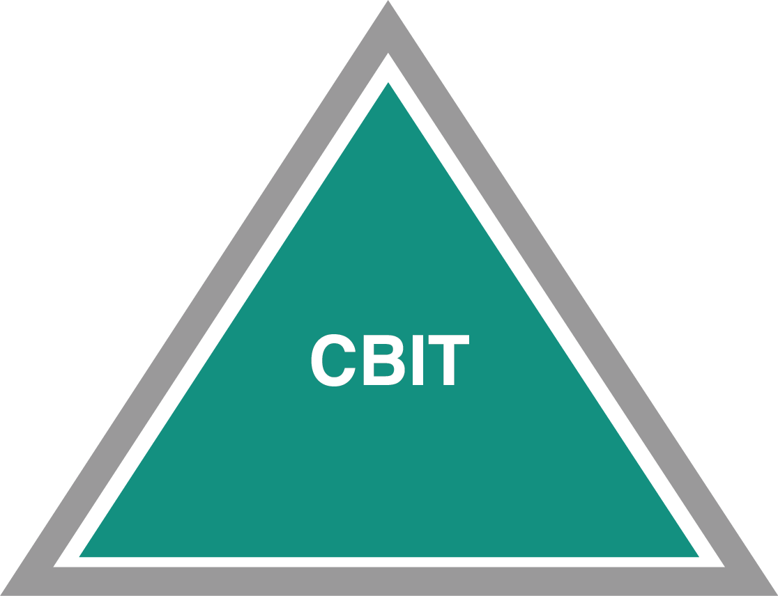
Cross Border Irrevocable Trust (CBIT)
Owning US property in a CBIT shields the property from US estate tax
This avoids adverse US or Canadian income and estate tax consequences.
Caution against using a standard Canadian family discretionary trust
Trustee:
Spouse
Beneficiaries:
Spouse & Kids

Slide 21
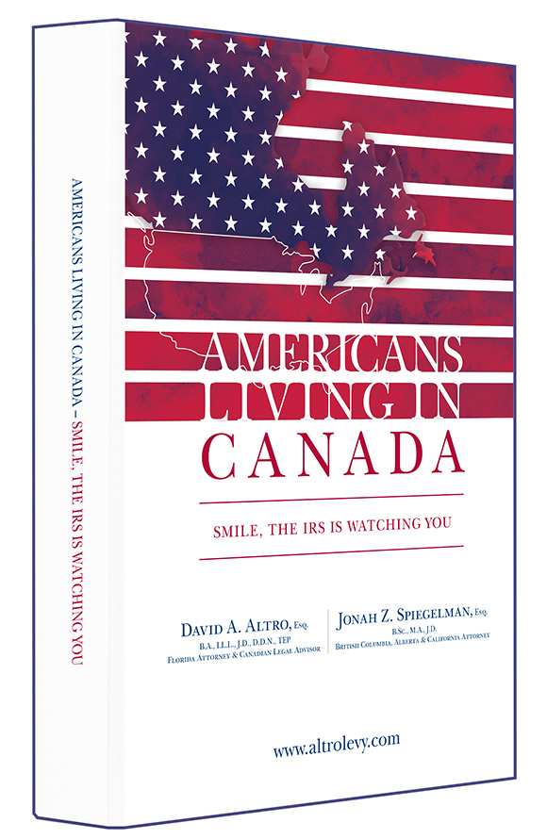
Inheritance Trust for Your Children
Who Are US Citizens or Residents
Do you have kids who are US citizens or reside in the US?
  How do you leave your estate to them?
A special Trust For Life has the following benefits:
  Protects your US child’s estate from US
  estate tax
  Protects the inheritance from inclusion in marital assets in case of divorce
  Protects inheritance from US child’s creditors
Tax issues for Americans living in Canada

Slide 22
Qualified Domestic Trust (QDOT)
If you’re a US citizen, but your spouse is Canadian
  He or she may be required to pay US estate taxes on the property transferred at your death
Establishing a will with a QDOT
  Allows Canadian spouse access to the marital deduction that’s available to US citizens
    Permitting:
      A transfer of the property to them
      Deferring the estate tax until they die

Slide 23
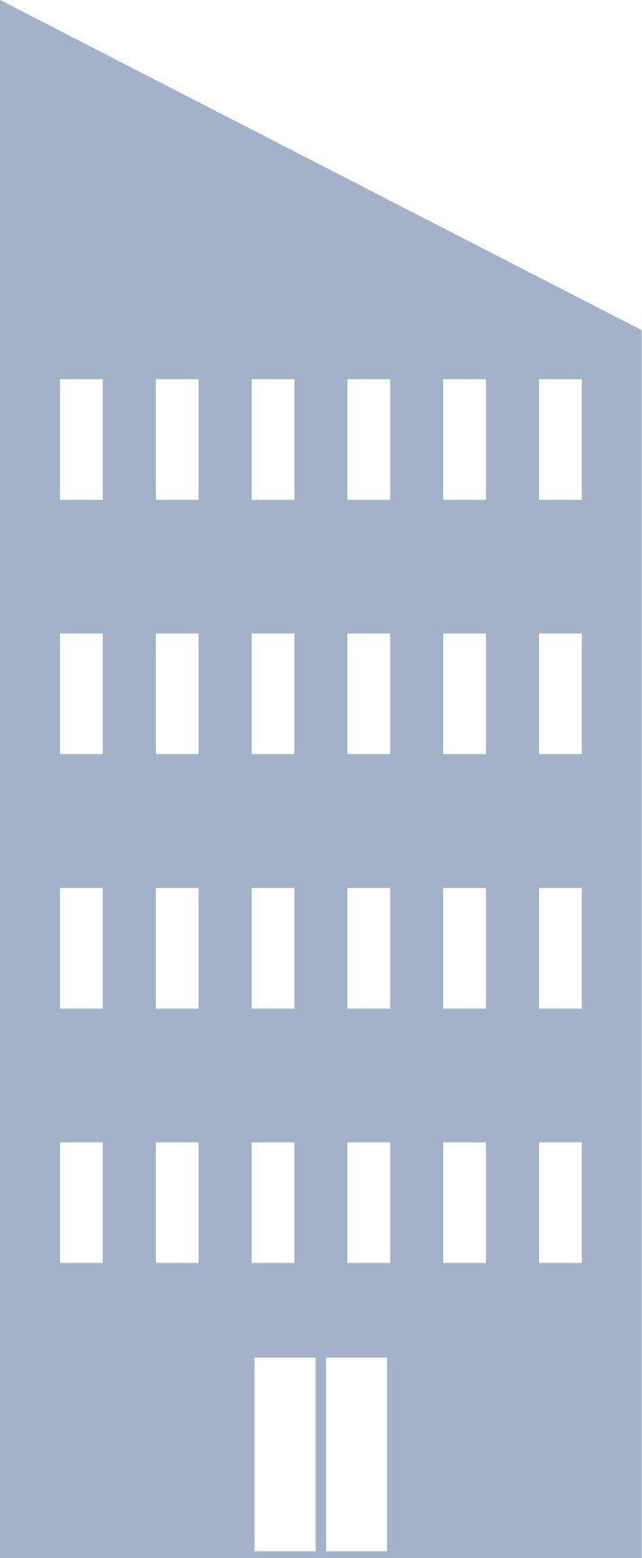
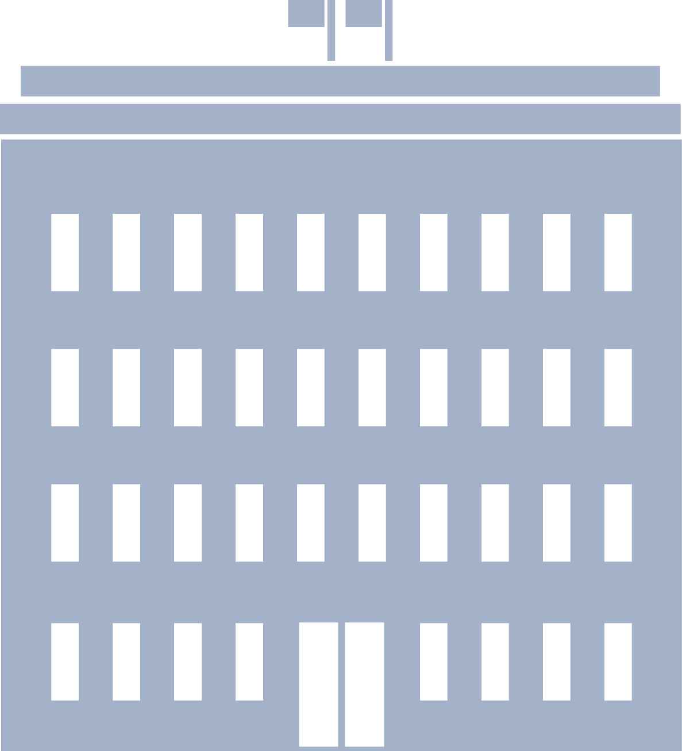

Rental Properties
What if your tenant sues you?
Tax
Issues
Reporting the income

Slide 24
Rental Properties: Limited Partnership*
100% Shareholder
Canadian Corporation
Limited Partner - 99.5%
Canada
General Partner - .5%
U.S.
Limited Partnership
US LP
*Not LLP or LLLP

Slide 25
Rental Properties: Two Tier Partnership
Canadian Corporation as
General Partner
Individual as Limited Partner in LP #2 & Director/ Shareholder of CanCo
GP - .5%
LP - 99.5%
Limited Partnership #2
US LP
Canada
Limited Partnership #1
US LP
U.S.
Corporation as
General Partner
GP - .5%
LP - 99.5%

Slide 26
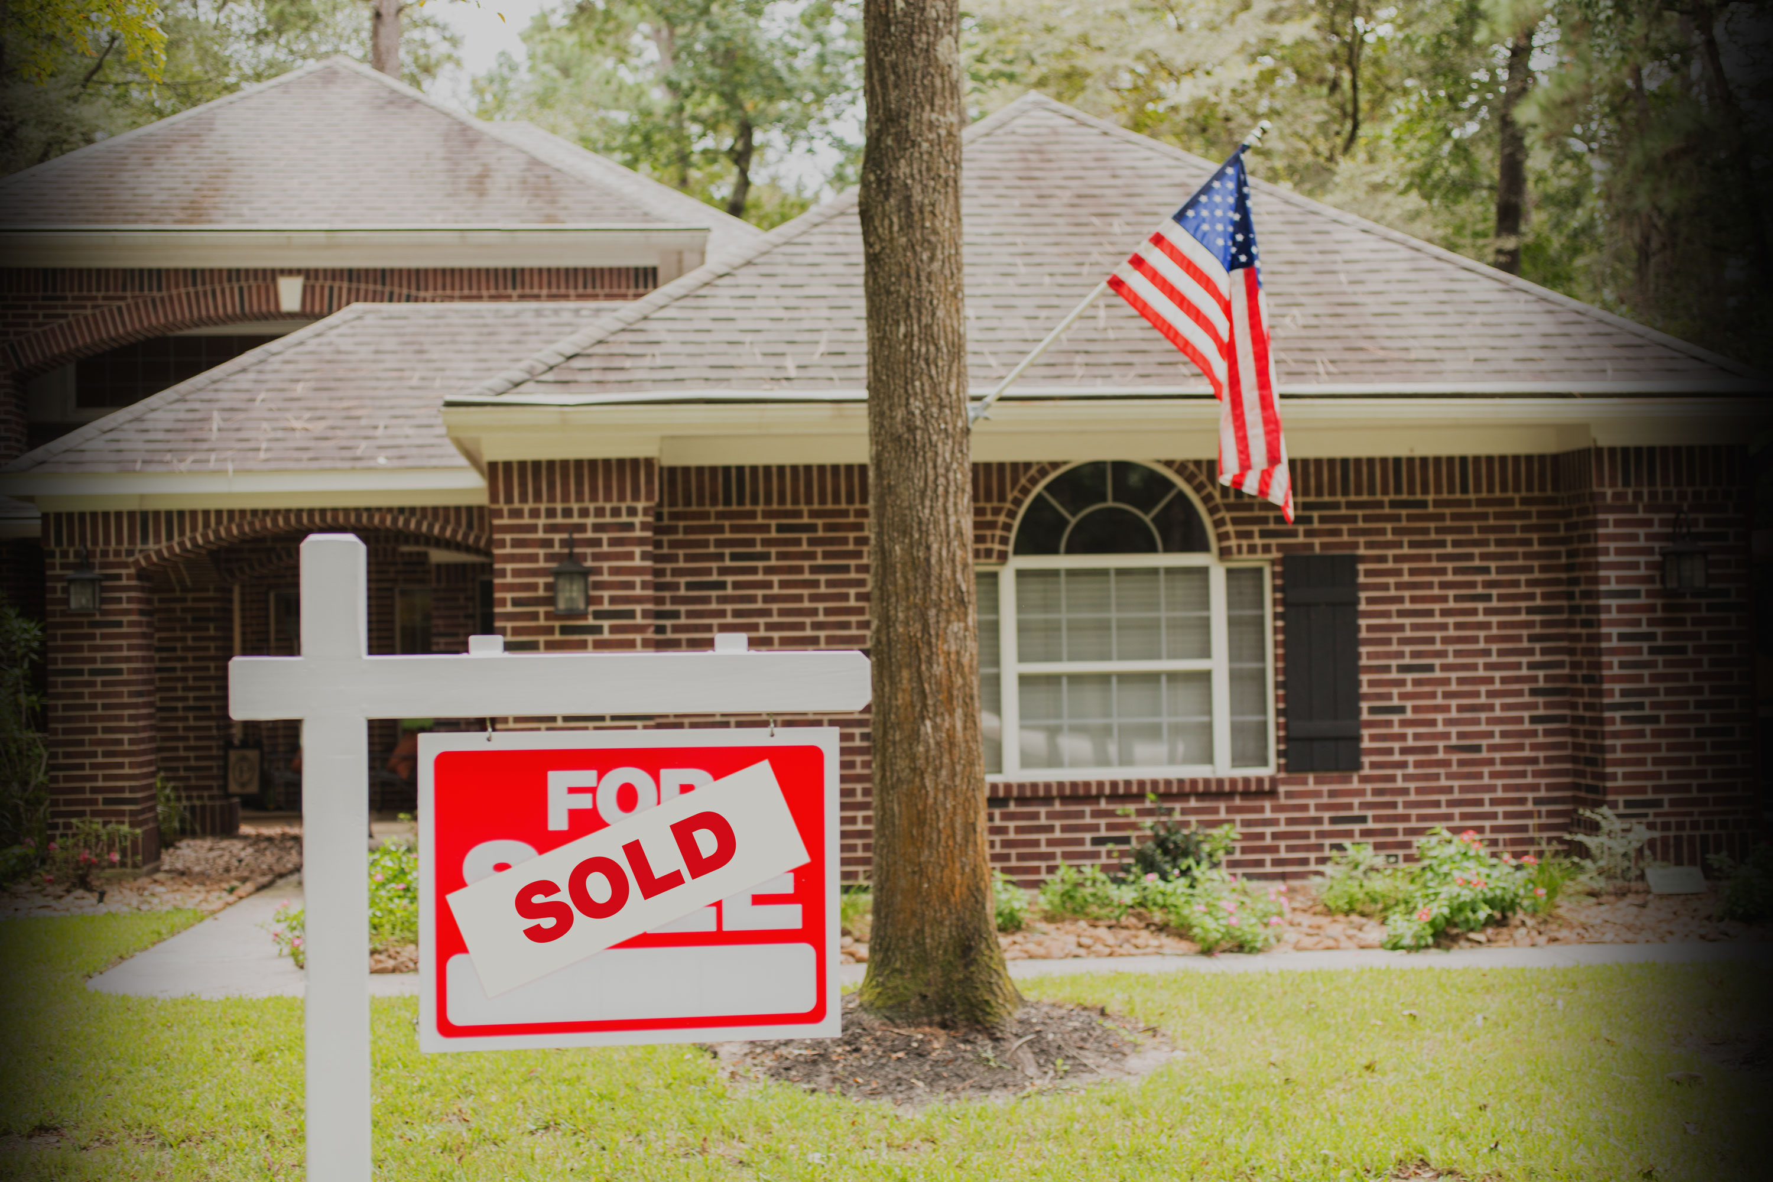
Selling Your US Property

Slide 27
“As Is” Contract
Provides no recourse against seller for problems that existed prior to the closing, for example:
  Water leaking through the roof or walls after rainfall
  Electrical problems
  Plumbing problems
  Mold
  Termites
An “As Is” purchase is not presumed, it must be clearly stated in the Contract for Sale and Purchase

Slide 28

Capital Gains Tax
If you sell your US property for a gain, do you have to declare tax to the IRS … to Canada?
What is FIRPTA (Foreign Investment in Real Property Tax Act)
What are the rules?
  Withholding rates: 10%, 15% or 35%?
FIRPTA Strategies
  Remitting the withholding to the IRS
  Exemptions from withholding
  Apply for a FIRPTA Withholding Certificate
1031 Like-Kind Exchange
  Double Taxation Issue

Slide 29
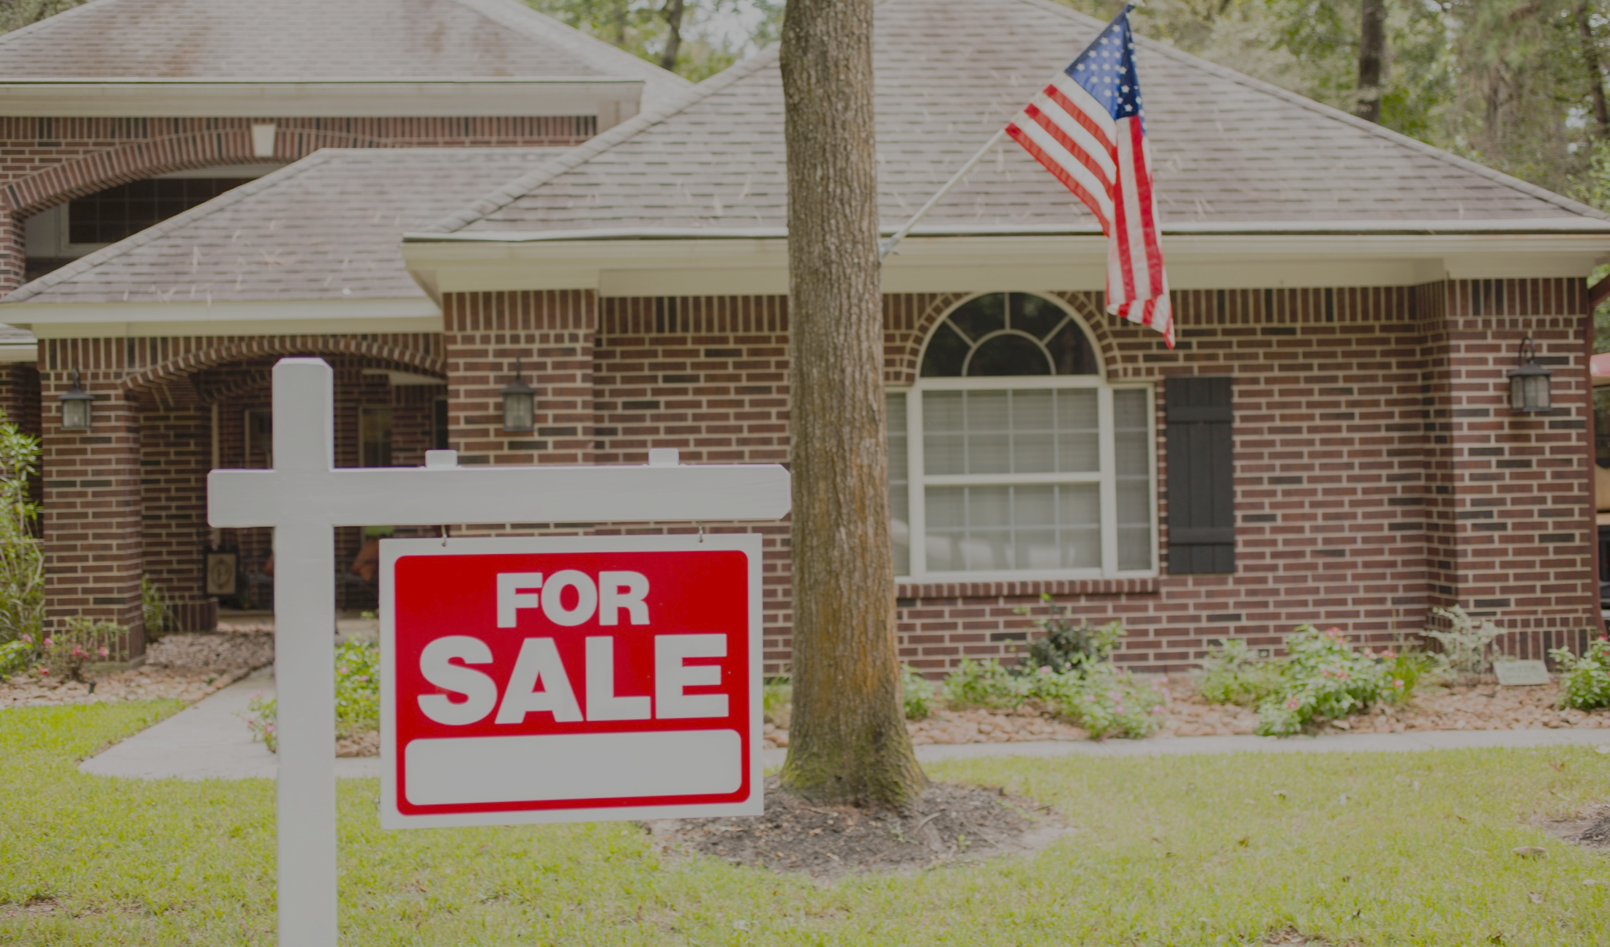
What happens if you become mentally incapacitated?
Client Scenario:
  “My parents own a condo together in Florida. They can’t enjoy it anymore since my mom developed dementia. My dad couldn’t sell the property because of my mom’s condition. So we had to do a costly and time consuming Florida guardianship procedure.”
Can your family sell the property?
Is your Canadian POA valid in Florida?
Florida Guardianship procedure

Slide 30
Cross Border Trust
Florida probate issues
Florida mental incapacity issues / guardianships
US capital gains and income tax
Canada Revenue Agency capital
gains and income tax
Foreign tax credits under the
Canada-US Tax Treaty
US Estate Tax
Protecting your children’s inheritance from
divorce marital assets
Asset protection for your children’s inheritance
Trustee:
You
Beneficiaries:
You

Slide 31
ALTRO LLP Services, Expertise and Clients
Canadians with US Real Estate
Tax & Estate Planning for US Citizens Living in Canada
Canadians Moving to the US
Immigration to the US
Tax & Estate Planning for Canadians
Corporate Reorganizations and Estate Freezes
American Residents Moving to Canada
Probate and Settlement of Estates in Canada and Florida
Our attorneys are licensed on both sides of the border

Slide 32
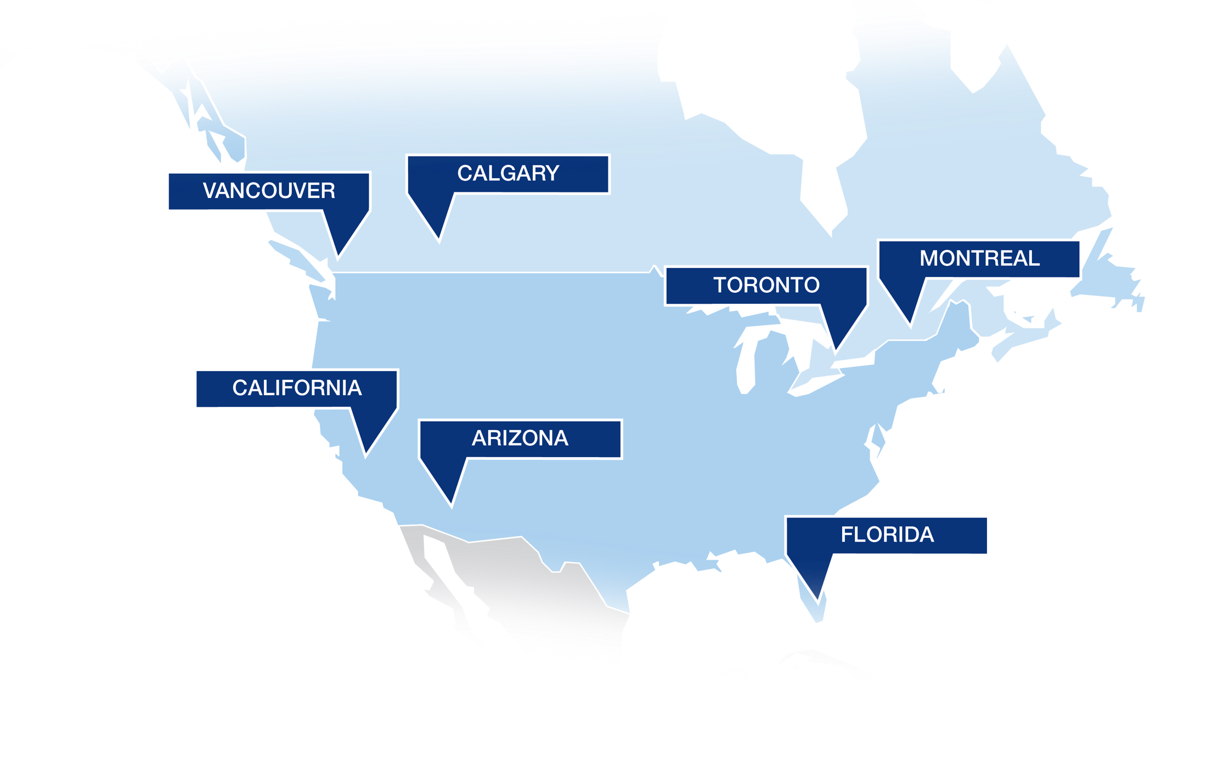
Offices
Montréal / Toronto / Calgary / Vancouver / Ft. Lauderdale / Orlando / Naples / Phoenix / Palm Springs

Slide 33
Montréal / Toronto / Calgary / Vancouver / Ft. Lauderdale / Orlando / Naples / Phoenix / Palm Springs
Analyze
Recommend
Implement
David A. Altro, B.A., LL.L., J.D., D.D.N., F.Pl., TEP
ALTRO LLP
daltro@altrolaw.com
1.888.GO.ALTRO
www.altrolaw.com

