Slide 1
Professionalism and the Entrepreneurial Path
Dr. Sandra Kauanui, Director
Daveler & Kauanui School of Entrepreneurship
Florida Gulf Coast University
“Making the Possible REAL”
Notes:
Add in future growth here?

Slide 2
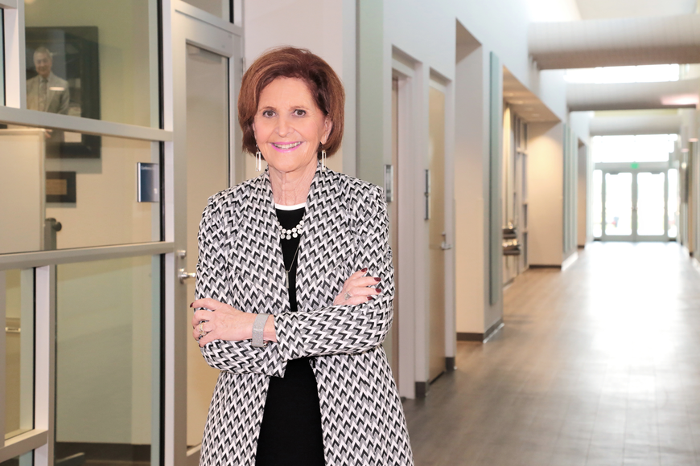
My Background
Entrepreneur
Second Career in Academia
California to FGCU
Being an Entrepreneur within a University Setting
Dr. Sandra Kauanui
Director, Daveler & Kauanui School of Entrepreneurship
Florida Gulf Coast University

Slide 3
Entrepreneurship and Real-Estate
The landscape of the world is changing, especially in Real-Estate
Impacts of Covid-19
Innovation and entrepreneurship are critical now more than ever
In a standardized trade, how do you think outside of the box?
Choosing and pivoting your business model based on the landscape and your changing customer

Slide 4
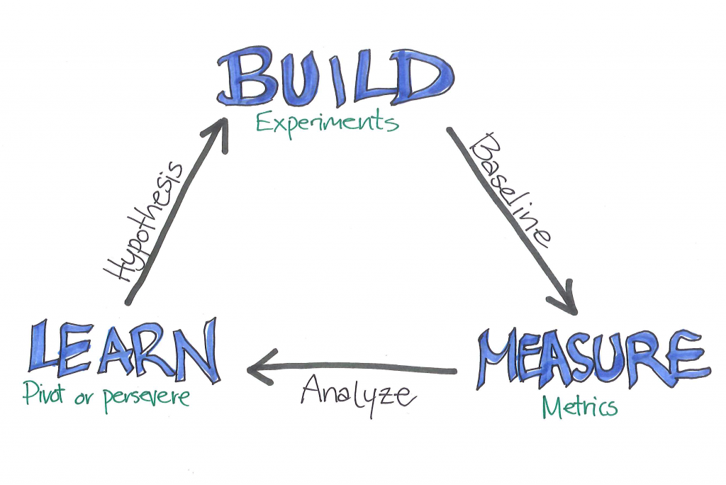
Entrepreneurship is Built around Core Values
Entrepreneurship is based on a core set of values, and doing the right thing for your “customers”
Understanding the customer and the problem they face is key!
Understand your Problem:
What problem are you solving?
Where are the biggest holes in your industry?
Who has this problem?
How do you know what you’re solving is a problem?
Obtain Problem Validation:
Talking with potential customers:
Do not ask leading questions
Ask people other than your friends and family
Research your competitors:
What are they doing well?
What problems still exist?

Slide 5
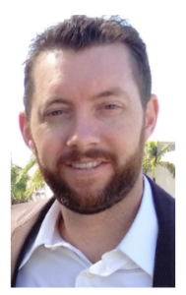
The School of Entrepreneurship: A Lean Timeline
Fall 2014: Minor in Entrepreneurship (Interdisciplinary)
January 2016: Veterans FL Entrepreneurship Program (Repurposing)
1 Program Coordinator
August 2016: Runway Program Flow-Through Grant
2 Program Coordinators
Student Interns
July 1, 2017:
Had to fire all staff due to lack of funding, they came in anyways (passion and purpose)
August 2018:
B.A. Interdisciplinary Entrepreneurship Studies
Entrepreneurship Living-Learning Community
July 1, 2019: Separated from the College of Business
August 2020: Naples Business Accelerator Program
Steve Berge, VFEP 2016

Slide 6
Our Values
STUDENT SUCCESS
Collaboration
Community
Ranked #30 Nationally by the Princeton Review
Ranked #1 in the State of Florida

Slide 7
VETERANS FLORIDA
ENTREPRENEURSHIP PROGRAM
$387,052
48 funded
Generating revenue of over $30+ million!
2 STARTUP/ YEAR
1 GROWTH/ YEAR
COMMUNITY
VETERAN
ENTREPRENEURS

Slide 8
RUNWAY PROGRAM
$531,650
71 funded
Generating revenue of over $9.9+ million!
STUDENT ENTREPRENEURS
ALUMNI ENTREPRENEURS

Slide 9
$167,350 in Scholarships awarded to 166 undergrad ENT students for 2020 Academic Year
160 Students Enrolled
480 Students Enrolled

Slide 10
MEETING STUDENT CAREER NEEDS
Business
Startup
Work in Existing Business to Innovate
Notes:
Meeting Student Career Needs

Slide 11
COMMUNITY OUTREACH
Building an Entrepreneurial
Eco-System in SWFL
Grants
Veterans Florida Entrepreneurship Program
Stephen Berge awarded by Governor Rick Scott
Awarded $387,052 in seed funding for Veterans since 2016
SWFL Community Foundation
Naples Business Accelerator Program
Funded by the Board of Collier County Commissioners
Accelerator training program for Collier County businesses
Richard M. Schulze Family Foundation
$300,000 Awarded to IFE:
Seed funding for Veterans
Seed funding for Runway Program Students
ENT Student Scholarships
Operating Expenses for IFE

Slide 12
NAPLES BUSINESS ACCELERATOR PROGRAM
PROGRAMMING
6-month training program featuring:
Bi-weekly training sessions
One-on-one mentorship from expert mentors
25+ hours of virtual training content
SERVING ENTREPRENEURS IN COLLIER COUNTY
OPEN TO FGCU RUNWAY PROGRAM ALUMNI AT
NO COST

Slide 13
In a Different Context: Matt Kucher, Showami
Notes:
Problem we solve: Agents have to be at every Buyer showing
Solution: Agents show homes on behalf of other agents
We have 40-50 agents in SW Florida that are available to show homes
Agents pay a fee ( minimum $39 per home shown )
Agents keep their client, commission and schedule.
Buyers get access when they want and not dependent on buyer agent schedule
Showing agent gets market knowledge, showing experience and make money on the side

Slide 14
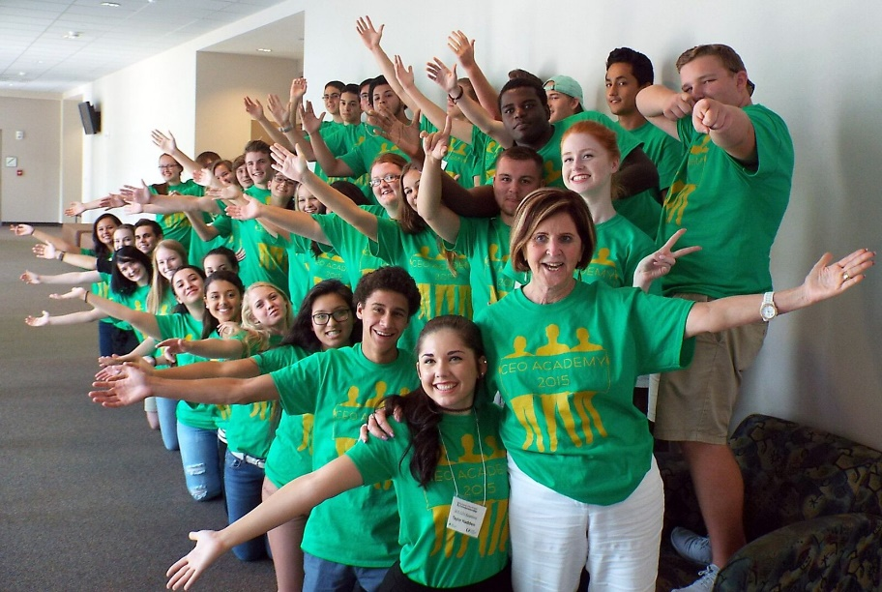
COMMUNITY OUTREACH
Additional Programs with Community Partners
Estero Economic Excellence Outreach Council
CEO Academy with Junior Achievement
CROP Academy with Power2Change
Immokalee Foundation ENT Summer Camp
Middle School Mentorship Program
Community Events
VenturePitch Events
NextGen Speaker Series
$1 Million Cups

Slide 15
OPPORTUNITIES FOR COMMUNITY
Mentorship
Veterans Florida Entrepreneurship Program
Runway Program Incubator
Naples Business Accelerator Program
ENT Courses at FGCU
Summer Camps
Judging
Runway Program Expo
Veterans Florida Entrepreneurship Program
Summer Camp Competitions

Slide 16
RESPONDING TO COVID-19
ADAPT & OVERCOME
Took all courses fully online and made them synchronistic
Moved Runway and VFEP to synchronous online, saw rise in engagement and completion
Hosted TIF Summer Camp fully online
Enrollment up 12% from last year!

Slide 17
OPPORTUNITIES FOR COMMUNITY
Entrepreneurship Master’s Certificate Program
Experiential training for graduate students
Requires completion of 12 credit hours of courses
Approved to submit materials to become a full Master’s of Science Degree
FGCU Complete Program
Specifically designed for non-traditional students looking to complete their degree program
Offer an FGCU Complete Interdisciplinary Entrepreneurship Studies Degree
Courses are typically offered at night, and in shorter, 8-week sessions
Scholarships are offered for this program

Slide 18
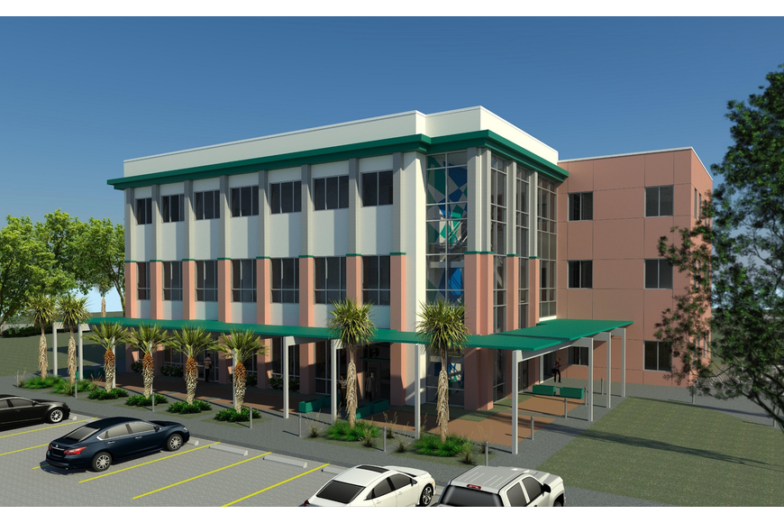
LOOKING FORWARD
A
NEW HOME
FALL 2021
$10.5 Million Raised in One Year!

Slide 19
Daveler & Kauanui School of Entrepreneurship
Q&A
Questions?
“Making the Possible REAL”
Notes:
Add in future growth here?

Slide 20
For more information or to register for any of our programs feel free to reach out to us:
Dr. Sandra Kauanui, Director
Email: skauanui@fgcu.edu
Phone: 239-590-7433
Notes:
[30 seconds]
Desire to help students make the possible real
Feel free to contact us

